Slide 1
Accessibility Measures
Yunguo Cai
11/06/2017

Slide 2
Work finished
2
Developed separate model for small and large city.
Implementing the model with a specified no-bus region.

Slide 3
Model Description
3
1000 people
100 zones
800 jobs
Quality: Set as a constant 1 for walking, 2 for bus and 3 for driving
HH(Household Position): random to get (x, y) coordinate
Work status: random assign work status to each person
Job Density: random to get (x, y) coordinate

Slide 4
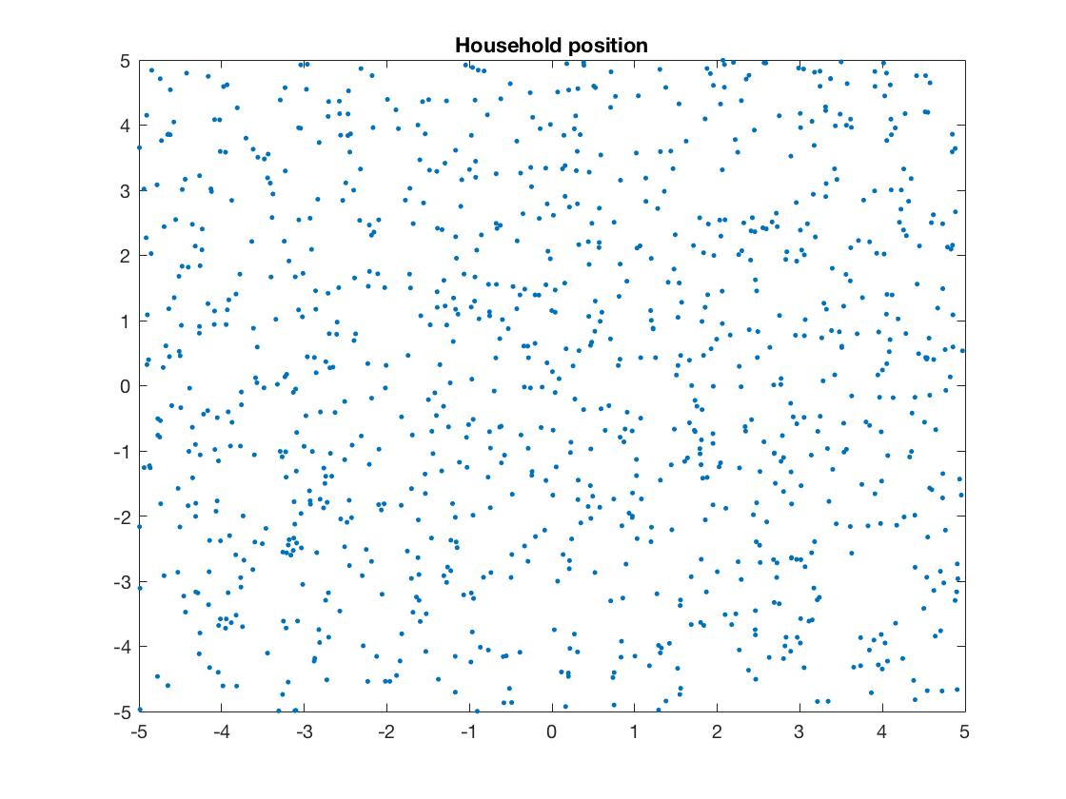
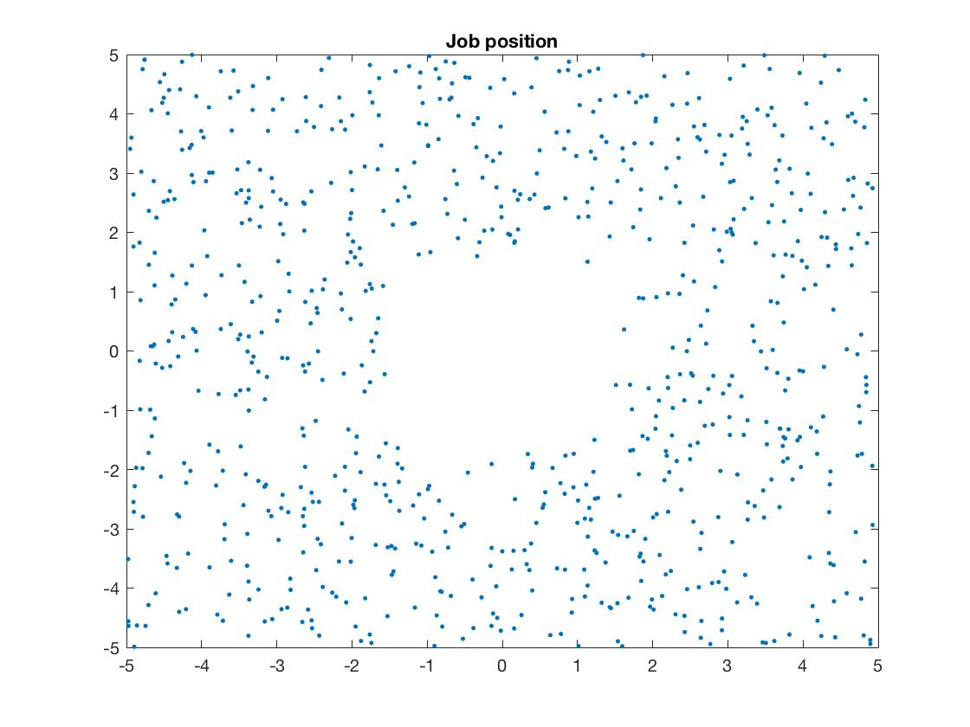
Model Description – Small City
4

Slide 5
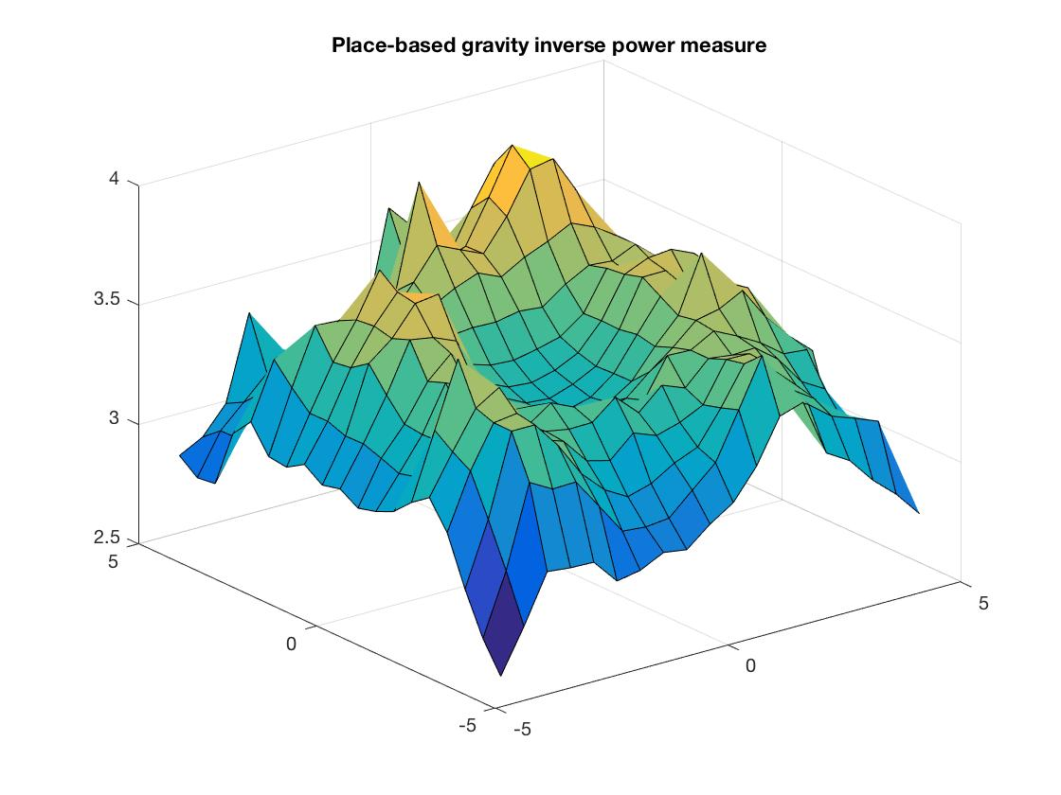
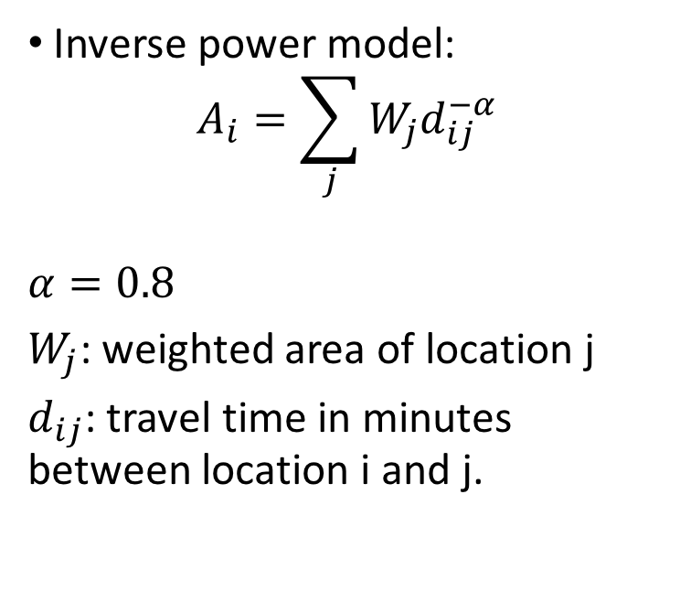
Place-based Access: Gravity type
5
Inverse power model:
$$A_{i}=\sum_{j}{W_{j}d_{ij}^{−α}}$$
$$α=0.8$$
$W_{j}$: weighted area of location j
$d_{ij}$: travel time in minutes between location i and j.
Bhat, M., Handy, S., Kockelman, K., and Mahmassani, H. “Assessment of Accessibility Measure.” Center for transportation research.
University of Texas at Austin.

Slide 6
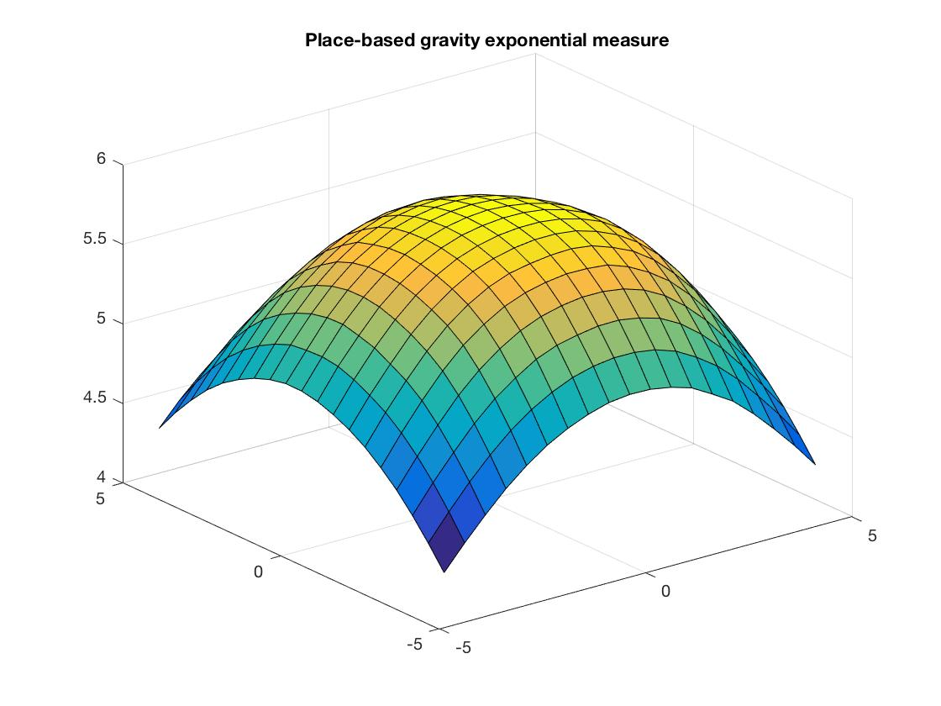

Place-based Access: Gravity type
6
Exponential model:
$$A_{i}=\sum_{j}{W_{j}e^{−βd_{ij}}}$$
where $β=0.12$.
Bhat, M., Handy, S., Kockelman, K., and Mahmassani, H. “Assessment of Accessibility Measure.” Center for transportation research.
University of Texas at Austin.

Slide 7
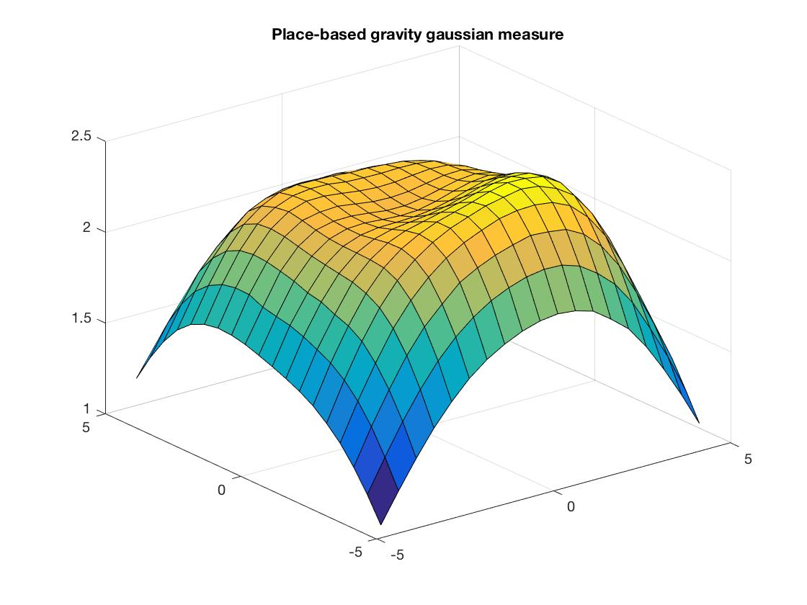

Place-based Access: Gravity type
7
Gaussian model:
$$A_{i}=\sum_{j}{W_{j}e^{−d_{ij}^{2}/v}}$$
where $v=10$.
Bhat, M., Handy, S., Kockelman, K., and Mahmassani, H. “Assessment of Accessibility Measure.” Center for transportation research.
University of Texas at Austin.

Slide 8
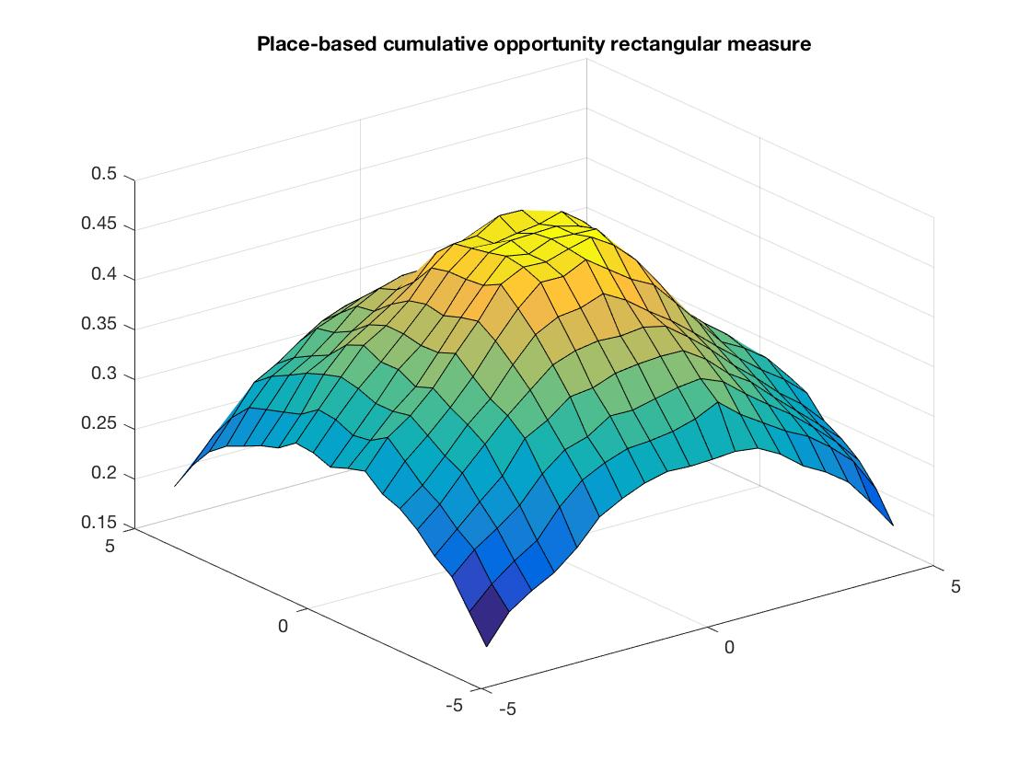
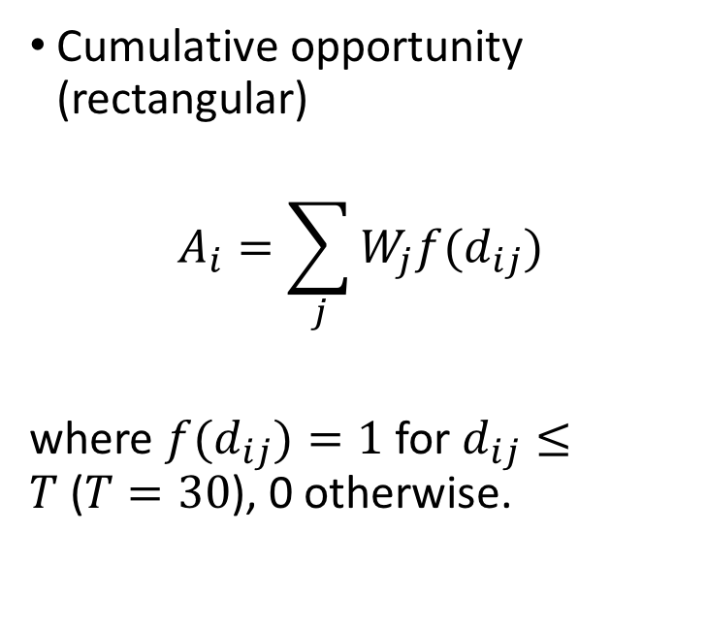
Place-based Access: Cumulative Opportunity
8
Cumulative opportunity (rectangular)
$$A_{i}=\sum_{j}{W_{j}f(d_{ij})}$$
where ${f(d}_{ij})=1$ for $d_{ij}≤T$($T=30$), 0 otherwise.
Bhat, M., Handy, S., Kockelman, K., and Mahmassani, H. “Assessment of Accessibility Measure.” Center for transportation research.
University of Texas at Austin.

Slide 9
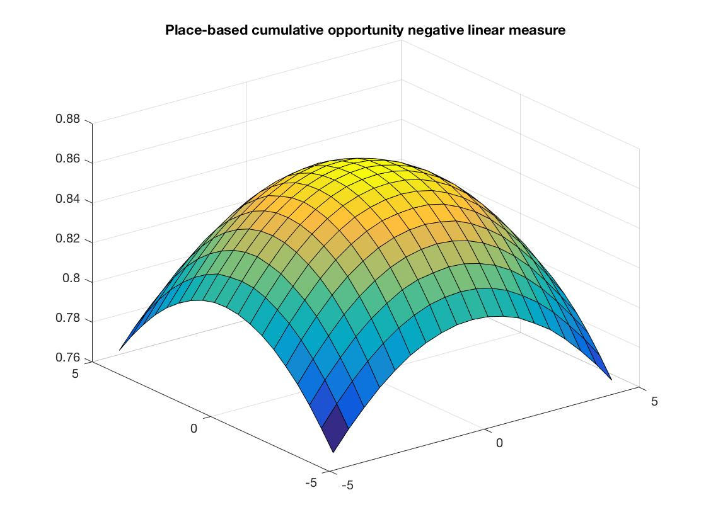
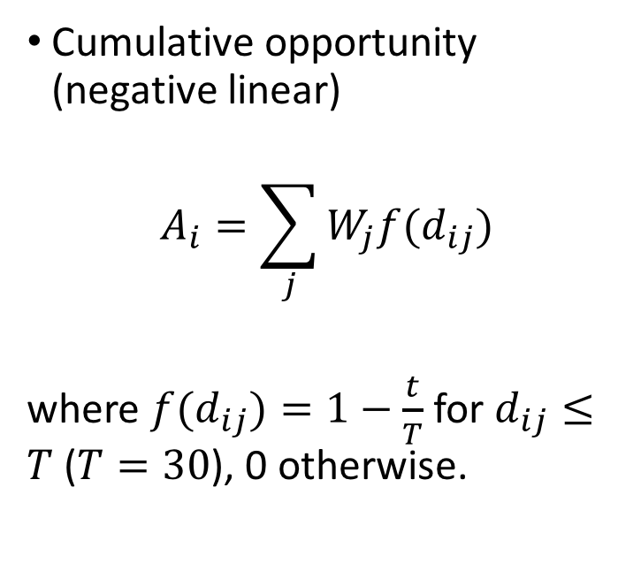
Place-based Access: Cumulative Opportunity
9
Cumulative opportunity (negative linear)
$$A_{i}=\sum_{j}{W_{j}f(d_{ij})}$$
where ${f(d}_{ij})=1−\frac{t}{T}$ for $d_{ij}≤T$ ($T=30$), 0 otherwise.
Bhat, M., Handy, S., Kockelman, K., and Mahmassani, H. “Assessment of Accessibility Measure.” Center for transportation research.
University of Texas at Austin.

Slide 10
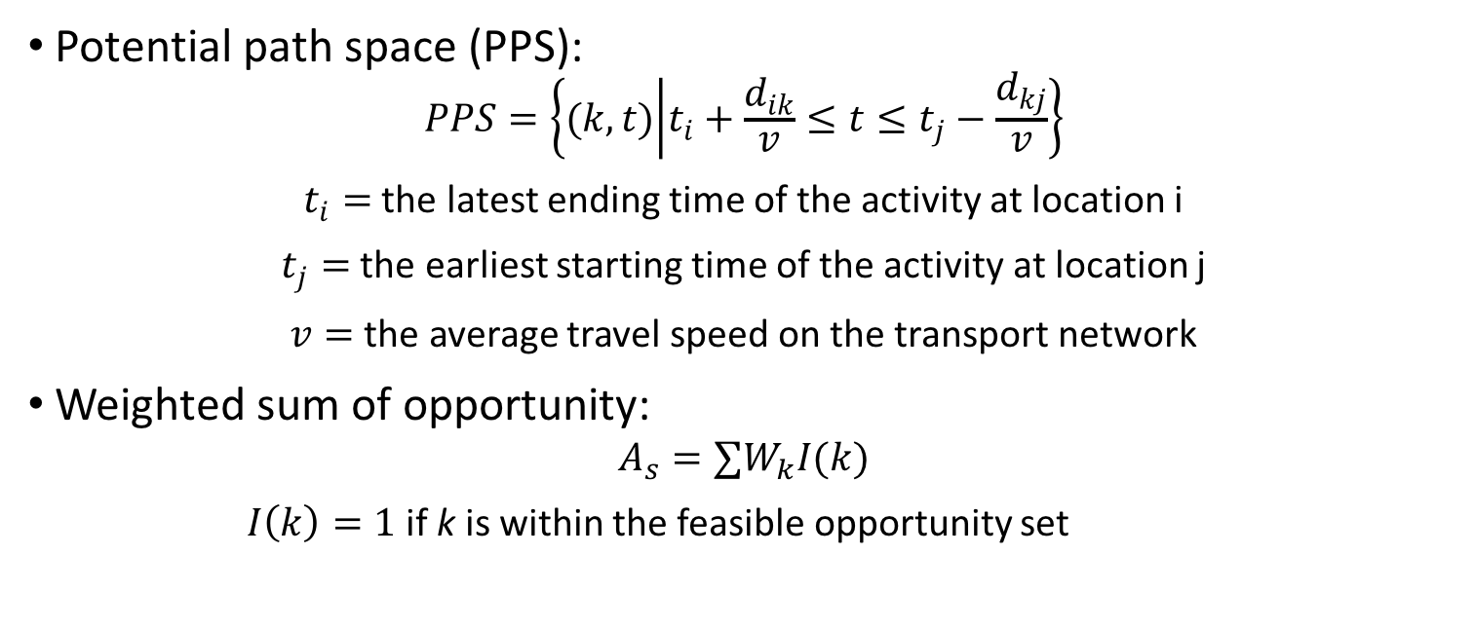
Individual-based Access: Time-Space
10
Potential path space (PPS):
$$PPS=\left\{(k,t) | t_{i}+\frac{d_{ik}}{v}≤t≤t_{j}−\frac{d_{kj}}{v}\right\}$$
$t_{i}=$ the latest ending time of the activity at location i
$t_{j}=$ the earliest starting time of the activity at location j
$v=$ the average travel speed on the transport network
Weighted sum of opportunity:
$$A_{s}=∑W_{k}I(k)$$
$I\left(k\right)=1$ if k is within the feasible opportunity set
Kwan, M. “Space-time and Integral Measure of Individual Accessibility: A Comparative Analysis Using a Point-based Framework.”
Geographical Analysis, Vol. 30, No. 3 (July, 1998) Ohio State University Press

Slide 11
Individual-based Access: Time-Space
11
100 activities happening in the area
Each person perform 5 activities with random position and starting and ending time.
For each activity, calculate whether it is within the range of potential path space (PPS).
Sum up all the activities that are reachable by the PPS.

Slide 12
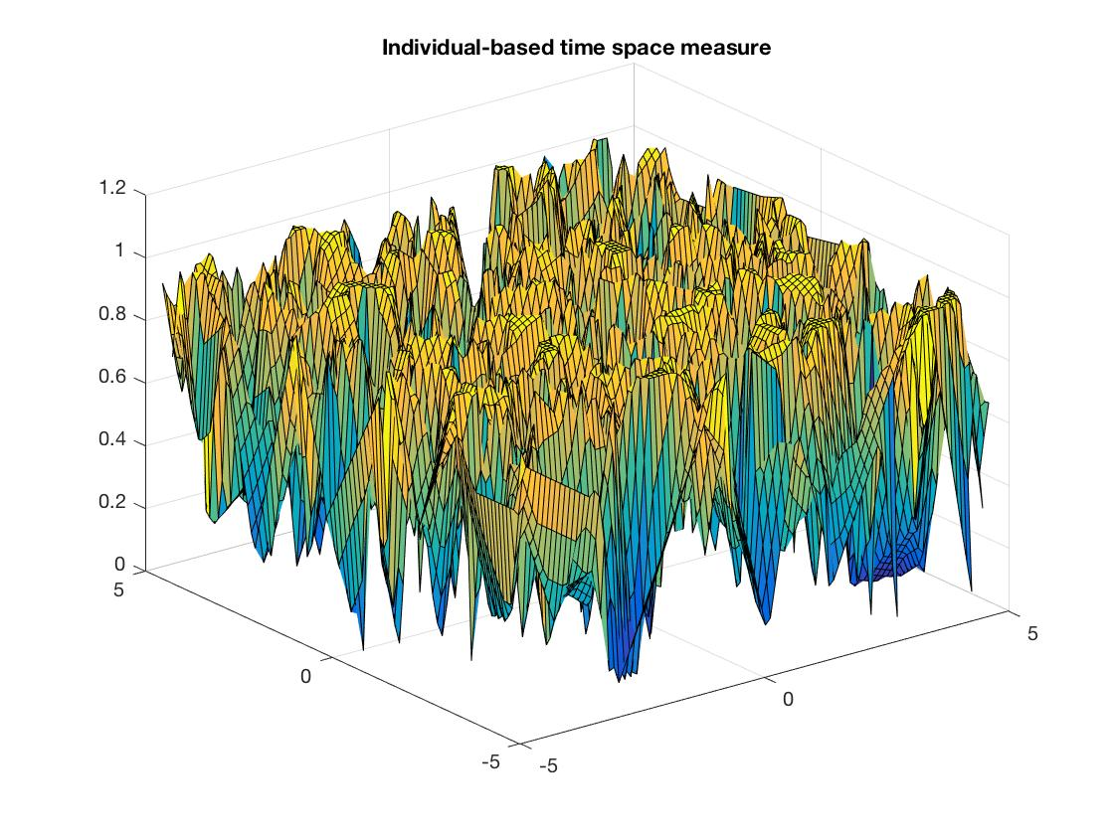
Individual-based Access: Time-Space
12

Slide 13
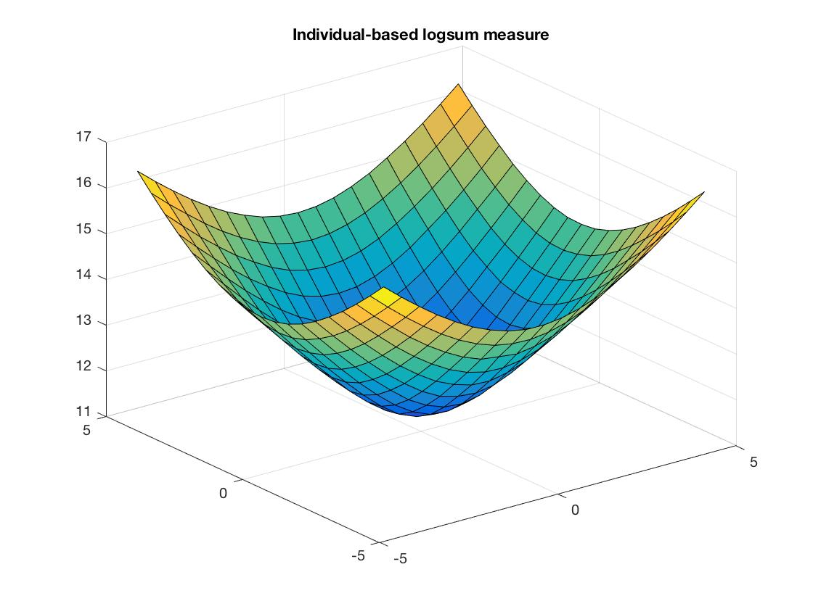
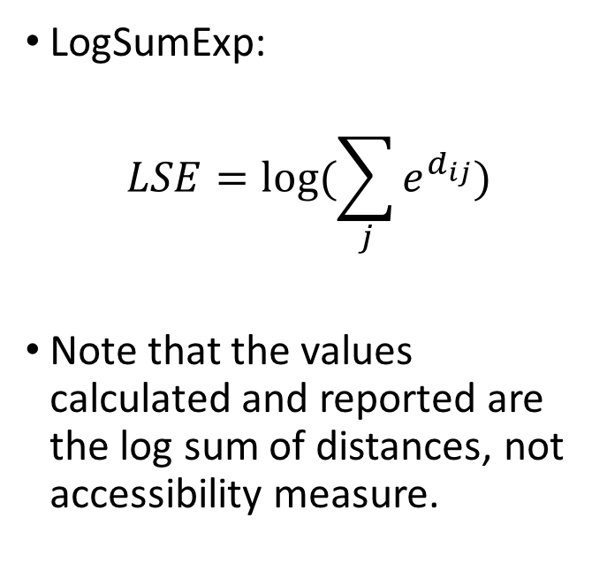
Individual-based Access: Logsum
13
LogSumExp:
$$LSE=log⁡(\sum_{j}{e^{d_{ij}}})$$
Note that the values calculated and reported are the log sum of distances, not accessibility measure.

Slide 14
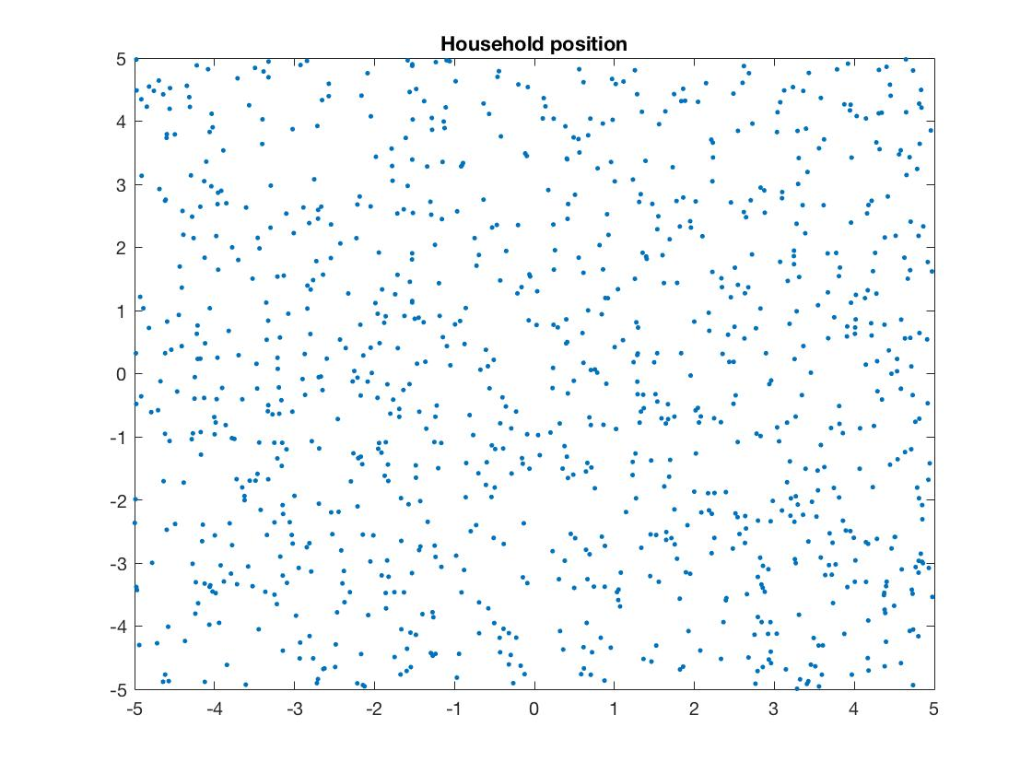
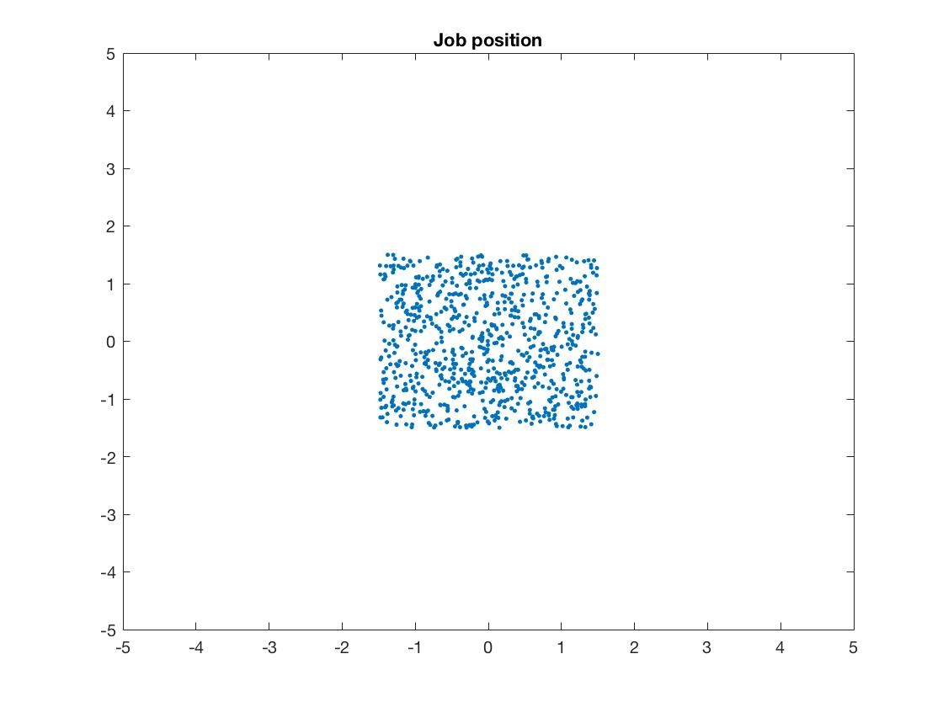
Model Description – Large City
14

Slide 15
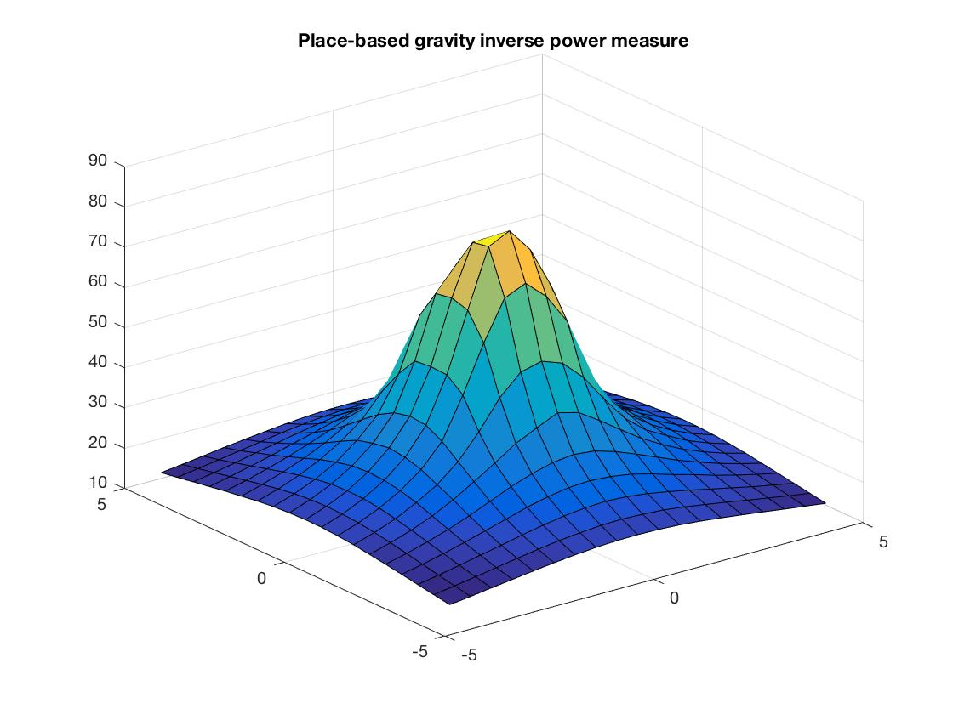
Place-based Access: Gravity type
15
Inverse power model:
$$A_{i}=\sum_{j}{W_{j}d_{ij}^{−α}}$$
$$α=0.8$$
$W_{j}$: weighted area of location j
$d_{ij}$: travel time in minutes between location i and j.
Bhat, M., Handy, S., Kockelman, K., and Mahmassani, H. “Assessment of Accessibility Measure.” Center for transportation research.
University of Texas at Austin.

Slide 16
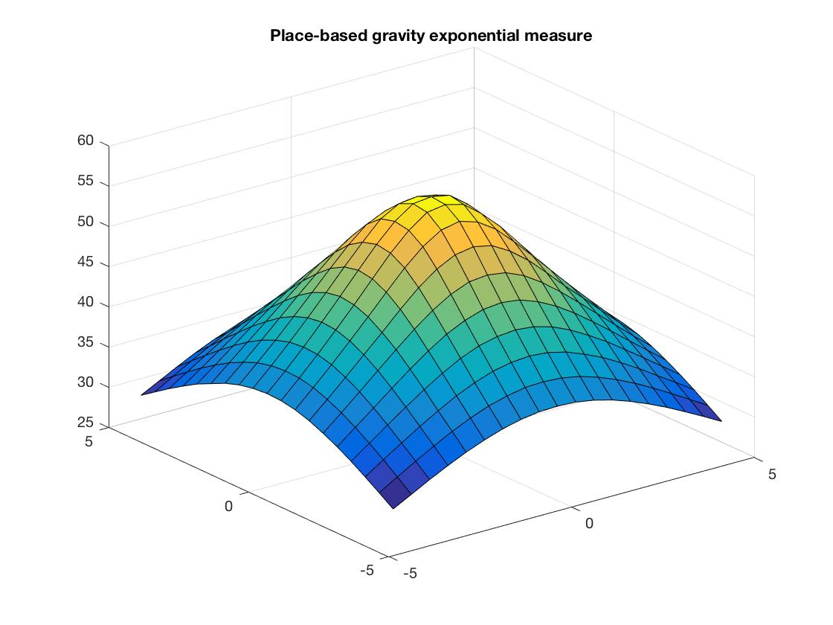
Place-based Access: Gravity type
16
Exponential model:
$$A_{i}=\sum_{j}{W_{j}e^{−βd_{ij}}}$$
where $β=0.12$.
Bhat, M., Handy, S., Kockelman, K., and Mahmassani, H. “Assessment of Accessibility Measure.” Center for transportation research.
University of Texas at Austin.

Slide 17
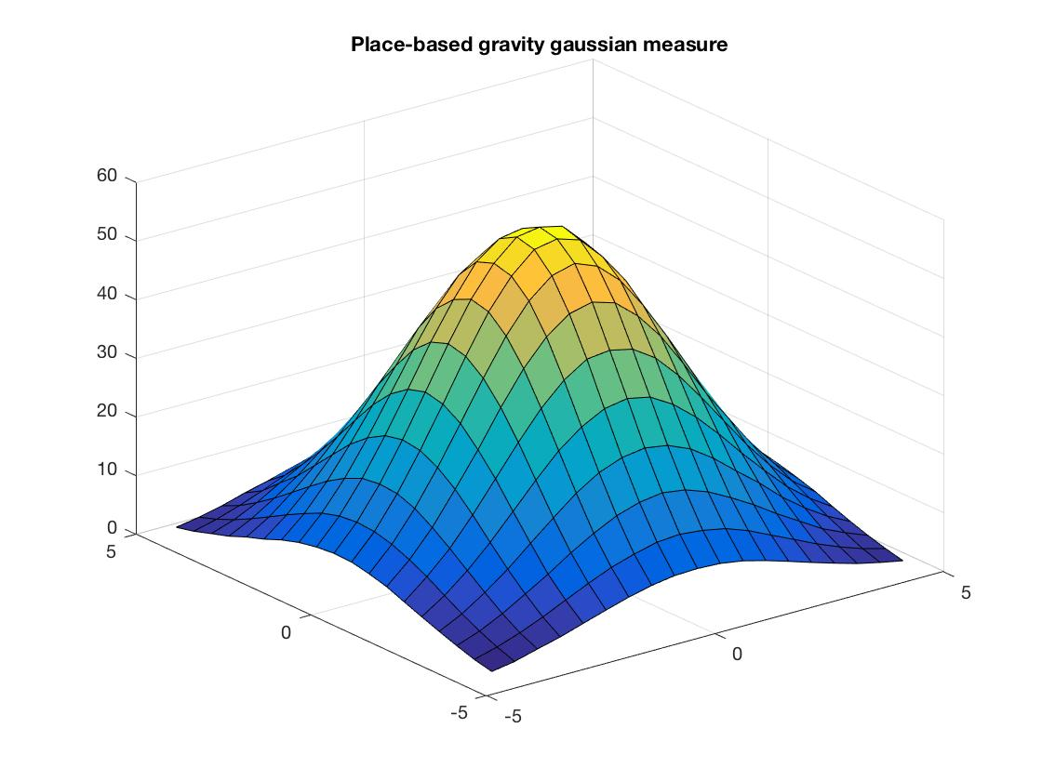
Place-based Access: Gravity type
17
Gaussian model:
$$A_{i}=\sum_{j}{W_{j}e^{−d_{ij}^{2}/v}}$$
where $v=10$.
Bhat, M., Handy, S., Kockelman, K., and Mahmassani, H. “Assessment of Accessibility Measure.” Center for transportation research.
University of Texas at Austin.

Slide 18
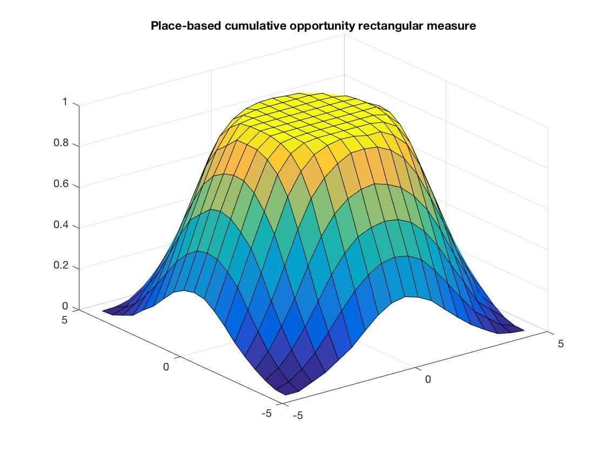
Place-based Access: Cumulative Opportunity
18
Cumulative opportunity (rectangular)
$$A_{i}=\sum_{j}{W_{j}f(d_{ij})}$$
where ${f(d}_{ij})=1$ for $d_{ij}≤T$($T=30$), 0 otherwise.
Bhat, M., Handy, S., Kockelman, K., and Mahmassani, H. “Assessment of Accessibility Measure.” Center for transportation research.
University of Texas at Austin.

Slide 19
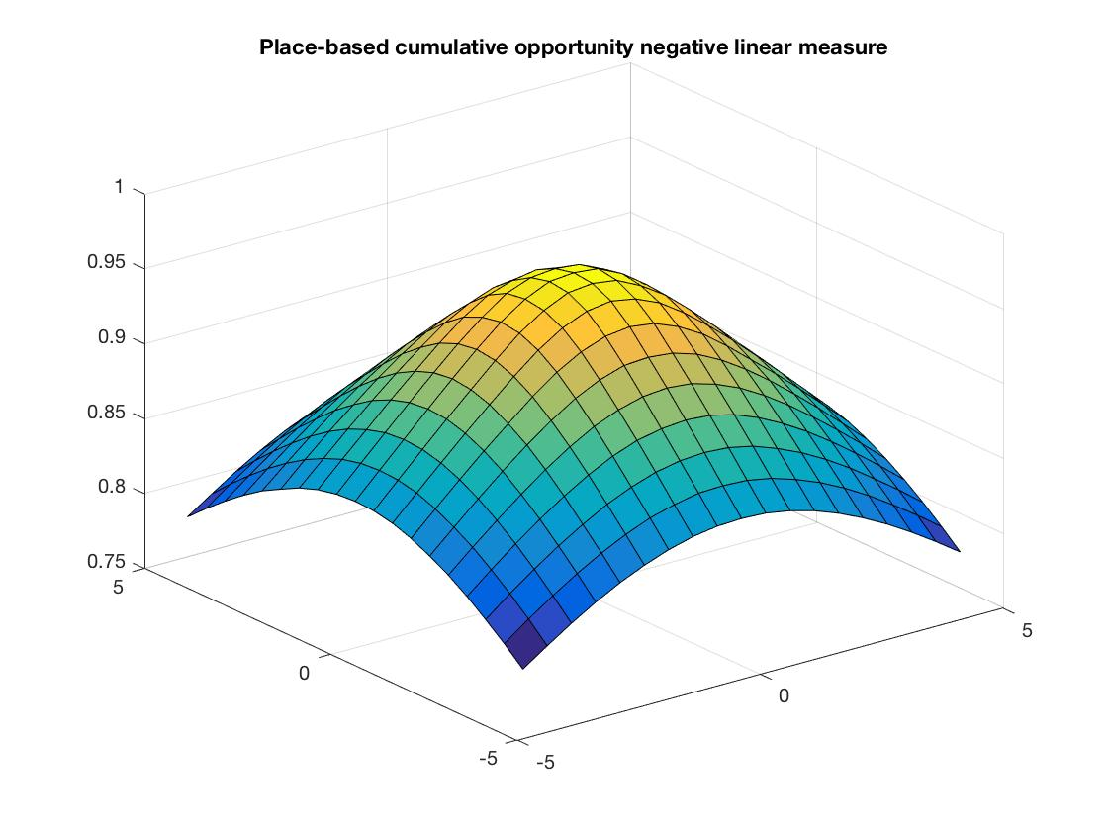
Place-based Access: Cumulative Opportunity
19
Cumulative opportunity (negative linear)
$$A_{i}=\sum_{j}{W_{j}f(d_{ij})}$$
where ${f(d}_{ij})=1−\frac{t}{T}$ for $d_{ij}≤T$ ($T=30$), 0 otherwise.
Bhat, M., Handy, S., Kockelman, K., and Mahmassani, H. “Assessment of Accessibility Measure.” Center for transportation research.
University of Texas at Austin.

Slide 20
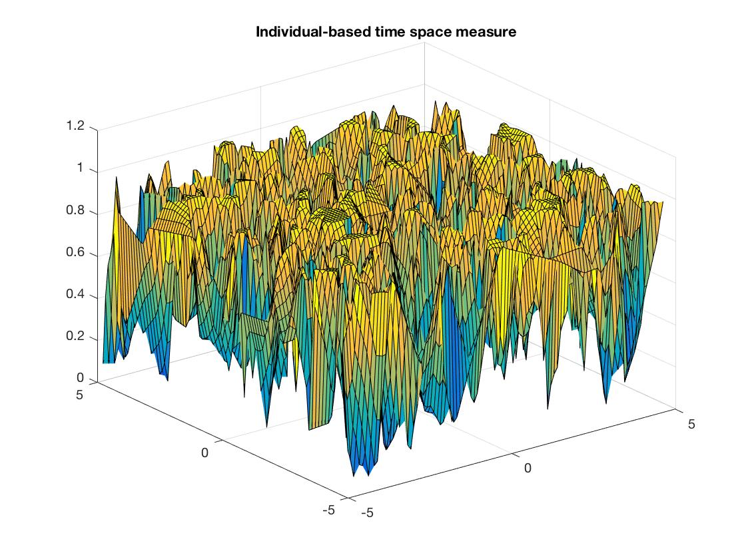
Individual-based Access: Time-Space
20

Slide 21
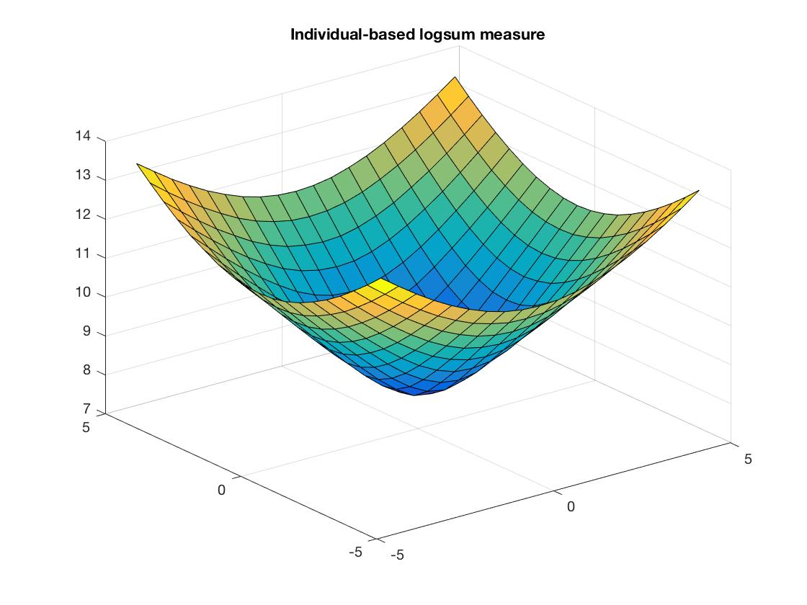
Individual-based Access: Logsum
21
LogSumExp:
$$LSE=log⁡(\sum_{j}{e^{d_{ij}}})$$
Note that the values calculated and reported are the log sum of distances, not accessibility measure.

Slide 22
No-bus region implementation
22
Inside the user-specified circular band, people travel by bus will be enforced to walk, while it has no influence on people with other travel means.
People’s travel paths are straight lines to their destinations.

Slide 23
Questions
23
Time-space measurement still looks strange potentially because the position and time are random assigned for each activity the person needs to perform during the day.
The no-bus region model have already been implemented but the results have not been collected.

